Slide 1
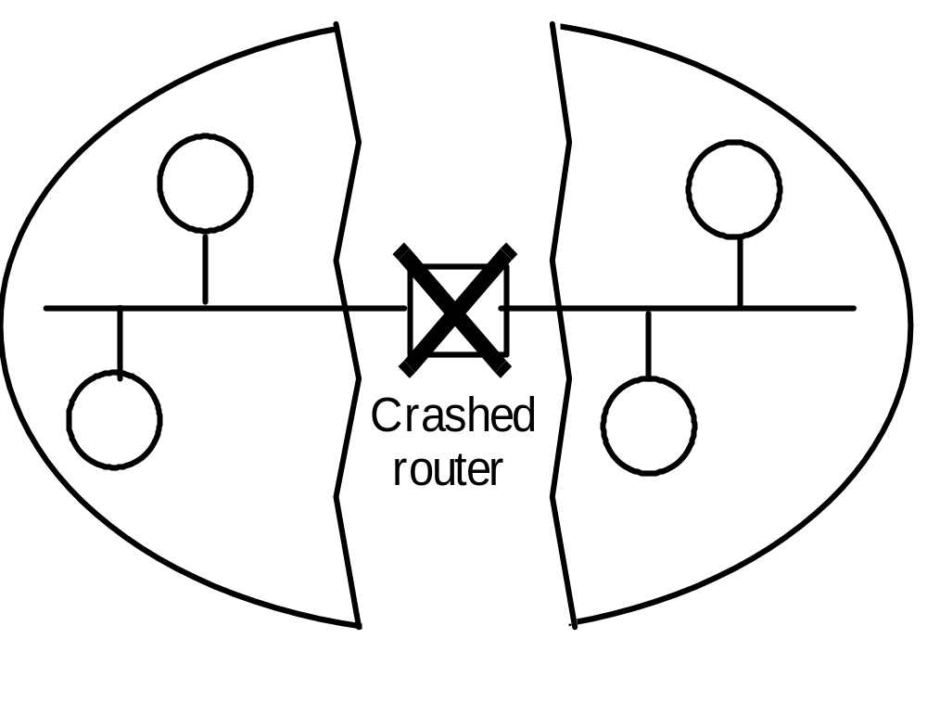
A network partition

Slide 2
Server managing a mutual exclusion token for a set of processes
Server
Queue of
requests
4
2
3. Grant
token
1. Request
token
2. Release
p
p
token
4
1
p
p
2
3

Slide 3
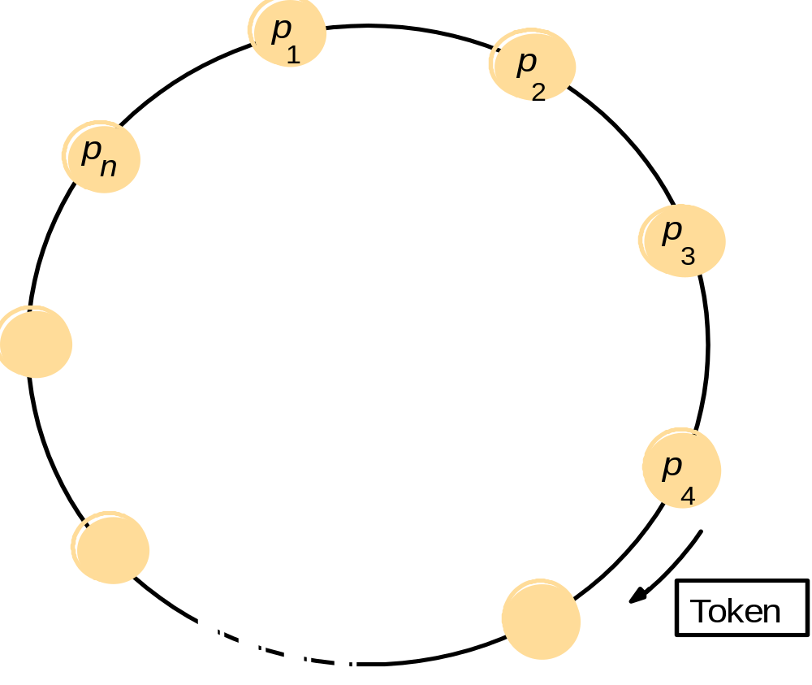
A ring of processes transferring a mutual exclusion token

Slide 4
Ricart and Agrawala’s algorithm
On initialization
state := RELEASED;
To enter the section
state := WANTED;
Multicast request to all processes; request processing deferred here
T := request’s timestamp;
Wait until (number of replies received = (N – 1));
state := HELD;
On receipt of a request <T_{i}, p_{i}> at p_{j} (i ≠ j)
if (state = HELD or (state = WANTED and (T, p_{j}) < (T_{i}, p_{i})))
then
queue request from p_{i} without replying;
else
reply immediately to p_{i};
end if
To exit the critical section
state := RELEASED;
reply to any queued requests;

Slide 5
Multicast synchronization
41
41
p
3
p
1
Reply
Reply
34
Reply
34
41
p
34
2

Slide 6
Maekawa’s algorithm – part 1
On initialization
state := RELEASED;
voted := FA_x0008_LSE;
For p_{i} to enter the critical section
state := WANTED;
Multicast request to all processes in V_{i};
Wait until (number of replies received = K);
state := HELD;
On receipt of a request from p_{i} at p_{j}
if (state = HELD or voted = TRUE)
then
queue request from p_{i} without replying;
else
send reply to p_{i};
voted := TRUE;
end if
For p_{i} to exit the critical section
state := RELEASED;
Multicast release to all processes in V_{i};
On receipt of a release from p_{i} at p_{j}
if (queue of requests is non-empty)
then
remove head of queue – from p_{k}, say;
send reply to p_{k};
voted := TRUE;
else
voted := FALSE;
end if

Slide 7
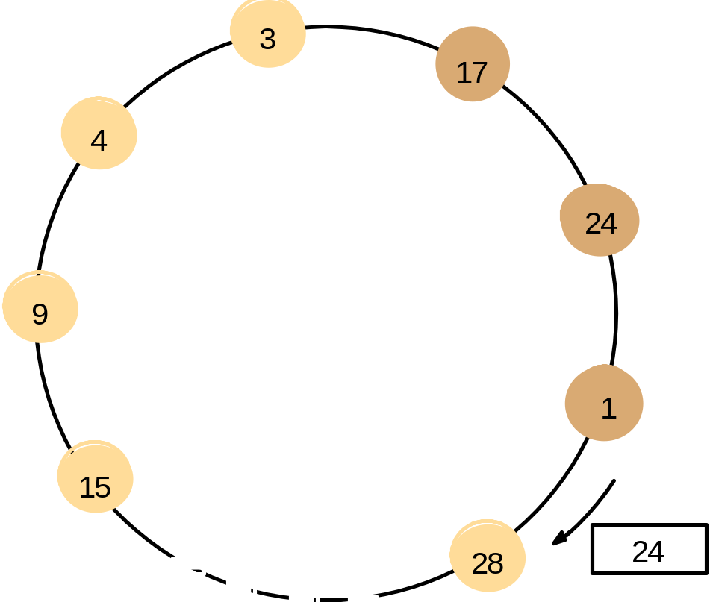
A ring-based election in progress
Note: The election was started by process 17.
The highest process identifier encountered so far is 24.
Participant processes are shown darkened

Slide 8
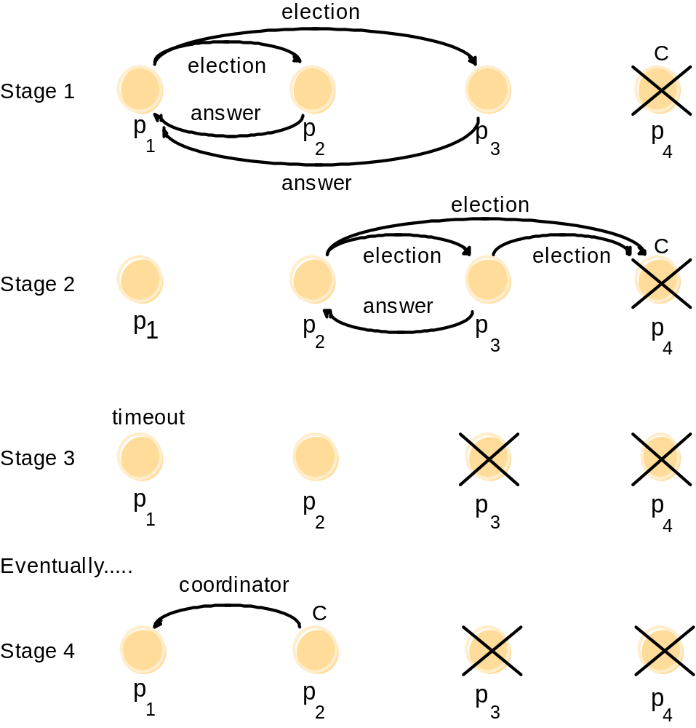
The bully algorithm
The election of coordinator p₂,
after the failure of p₄ and then p₃

Slide 9
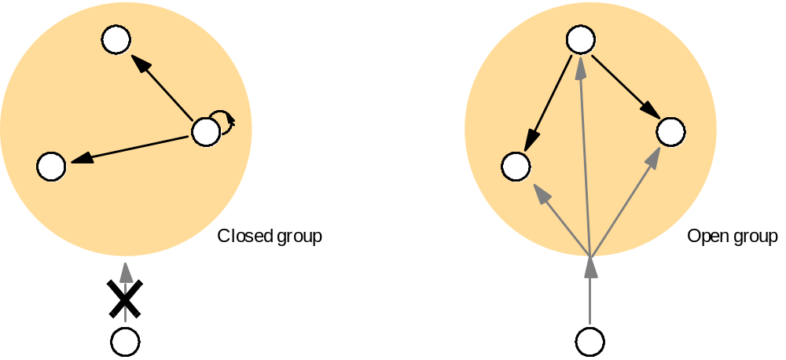
Open and closed groups

Slide 10
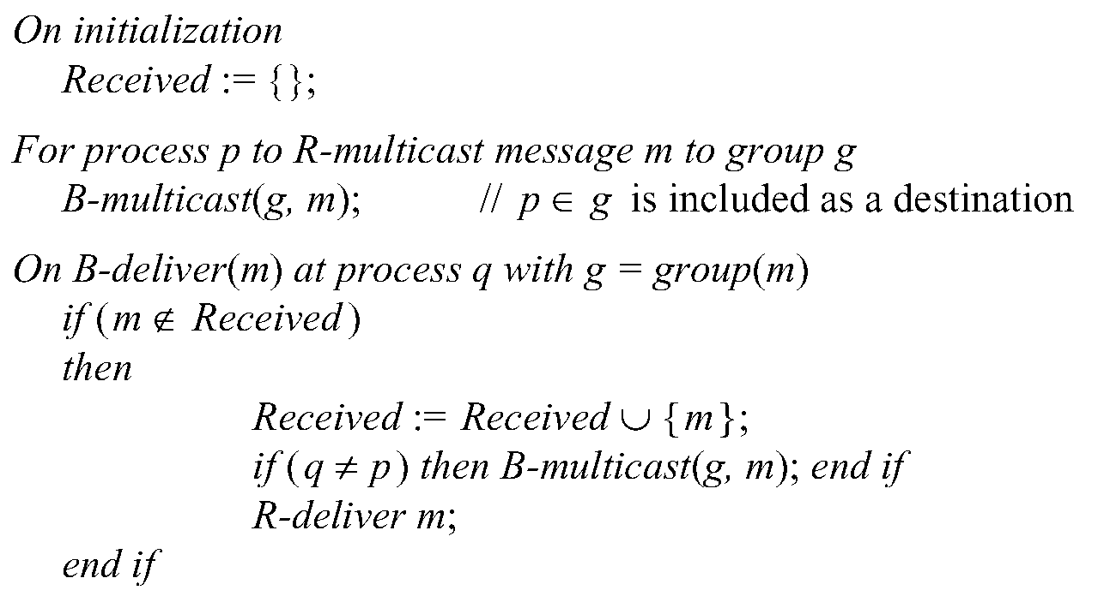
Reliable multicast algorithm

Slide 11
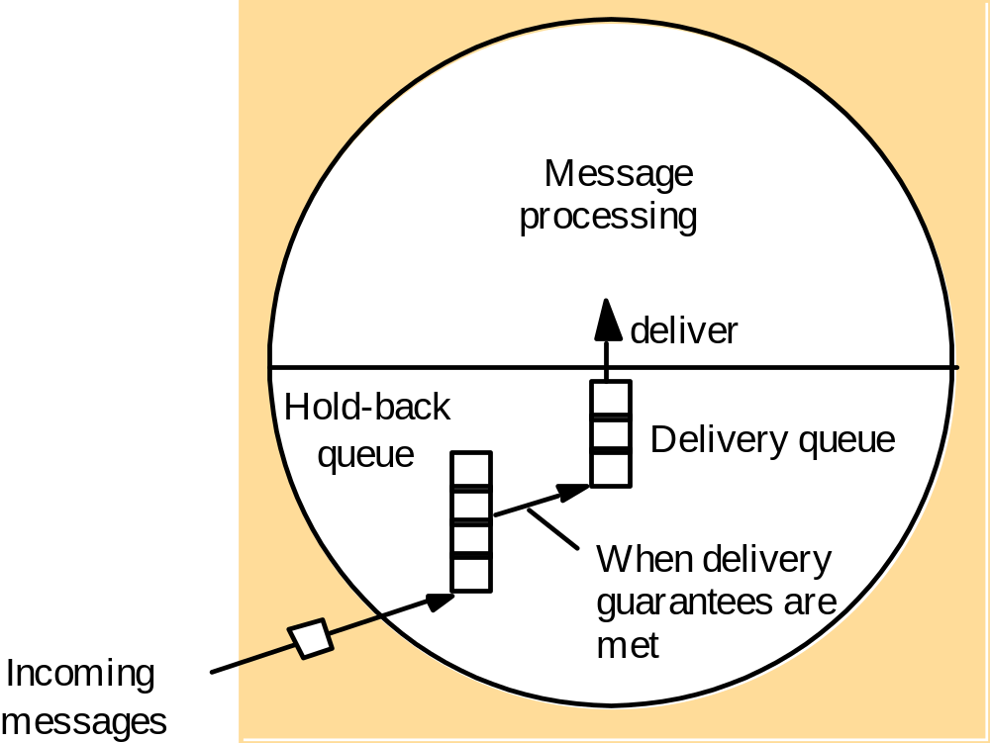
The hold-back queue for arriving multicast messages

Slide 12
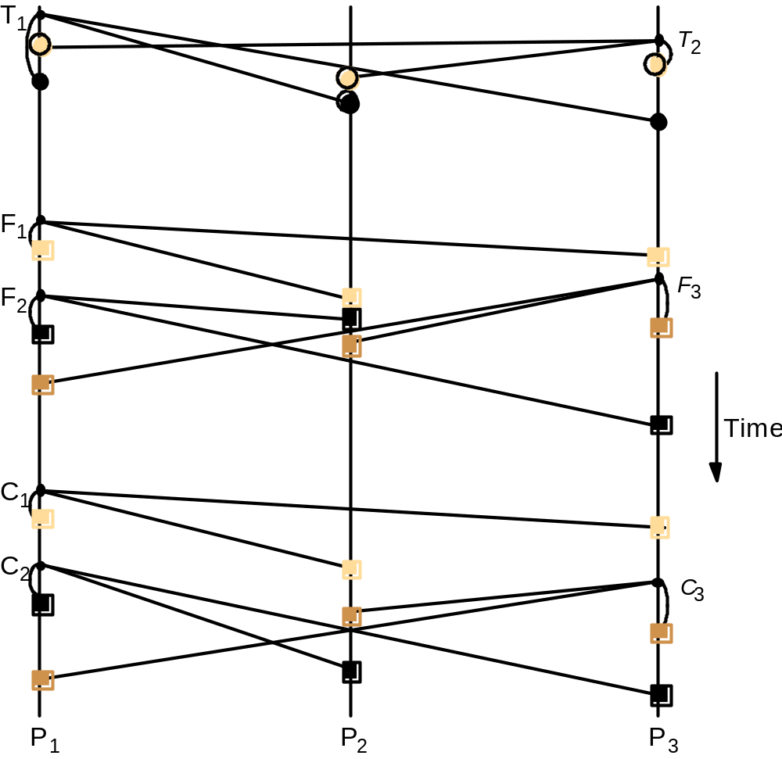
Total, FIFO and causal ordering of multicast messages
Notice the consistent ordering of totally ordered messages T₁ and T₂,
the FIFO-related messages F₁ and F₂ and the causally related messages C₁ and C₃
– and the otherwise arbitrary delivery ordering of messages.

Slide 13
Display from bulletin board program
Bulletin board:
os.interesting
Item
From
Subject
23
A.Hanlon
Mach
24
G.Joseph
Microkernels
25
A.Hanlon
Re: Microkernels
26
T.L’Heureux
RPC performance
27
M.Walker
Re: Mach
end

Slide 14
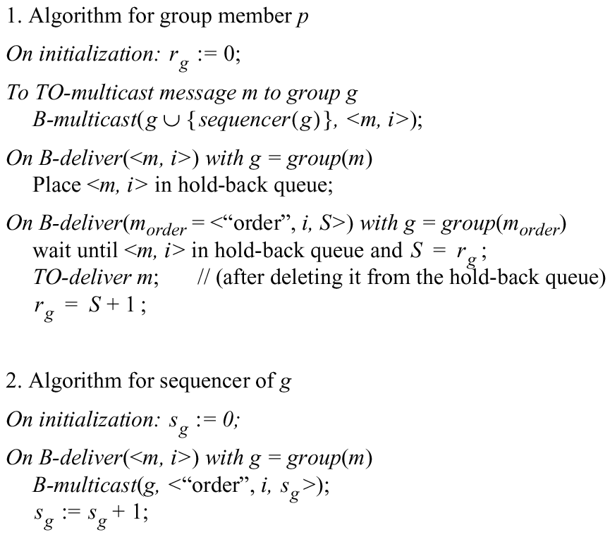
Total ordering using a sequencer

Slide 15
The ISIS algorithm for total ordering
P
2
1 Message
3
2
P
2
2 Proposed Seq
4
1
3 Agreed Seq
1
2
P
1
3
P
3

Slide 16
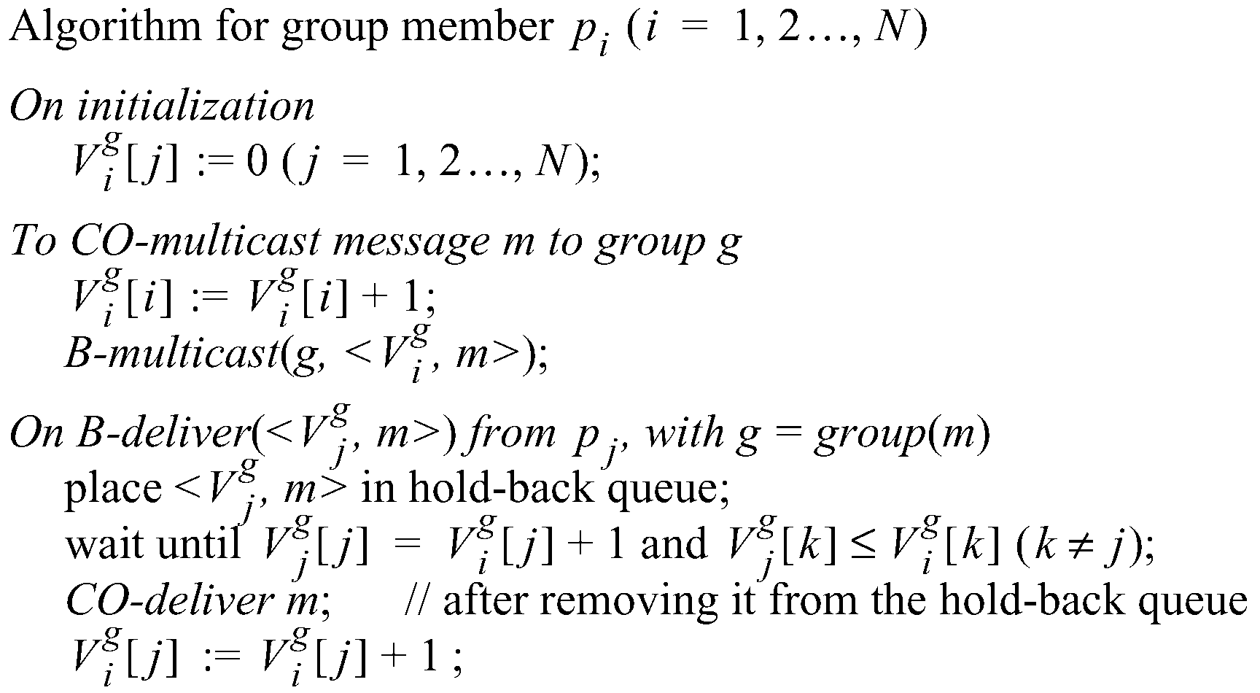
Causal ordering using vector timestamps

Slide 17
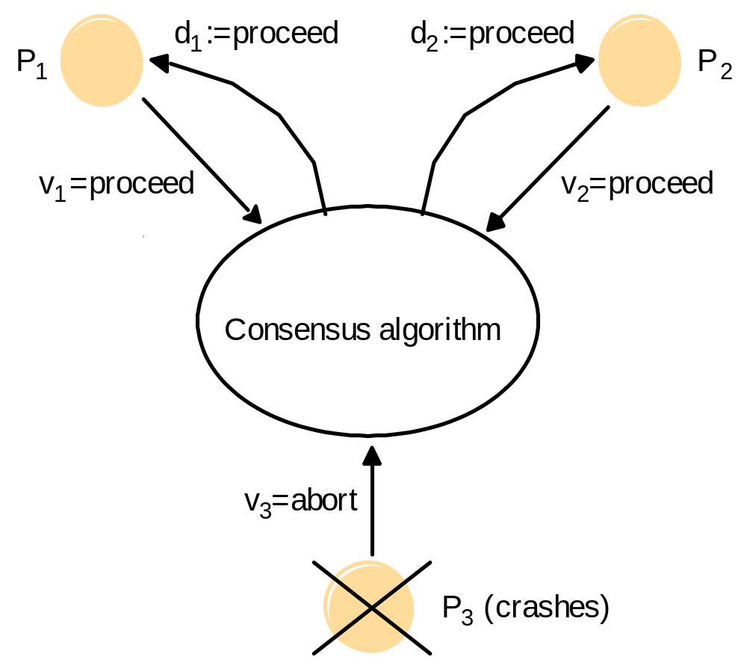
Consensus for three processes

Slide 18
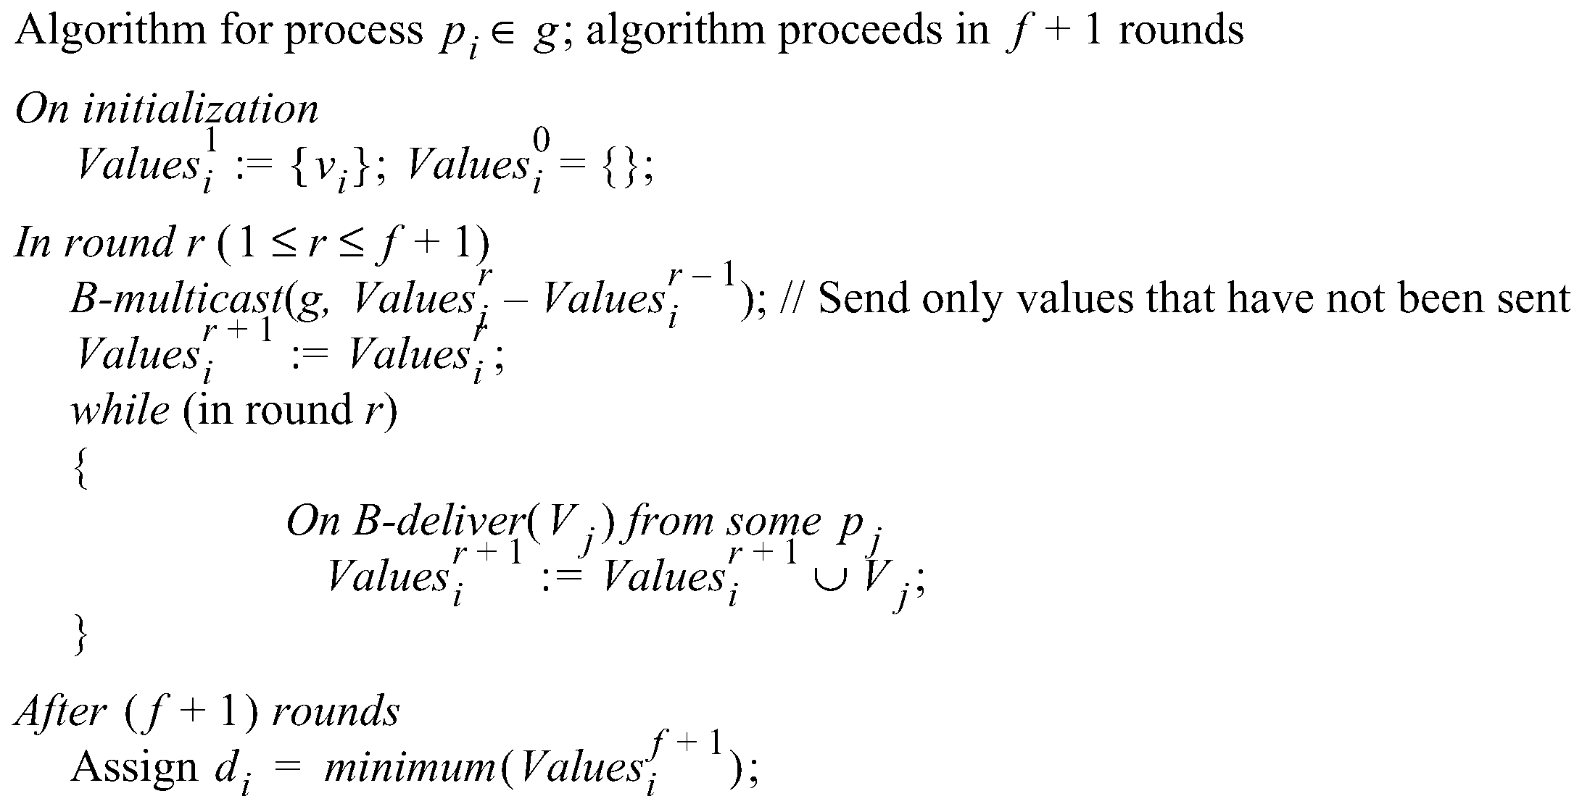
Consensus in a synchronous system

Slide 19
Three byzantine generals
p
1
(Commander)
p
1
(Commander)
1:v
1:v
1:w
1:x
2:1:v
2:1:w
p
2
p
3
p
2
p
3
3:1:u
3:1:x
Faulty processes are shown coloured

Slide 20
Four byzantine generals
p
(Commander)
p
(Commander)
1
1
1:v
1:v
1:u
1:w
1:v
1:v
2:1:v
2:1:u
p
3:1:u
p
p
3:1:w
p
2
3
2
3
4:1:v
4:1:v
4:1:v
4:1:v
2:1:v
3:1:w
2:1:u
3:1:w
p
p
4
4
Faulty processes are shown coloured

